Slide 1
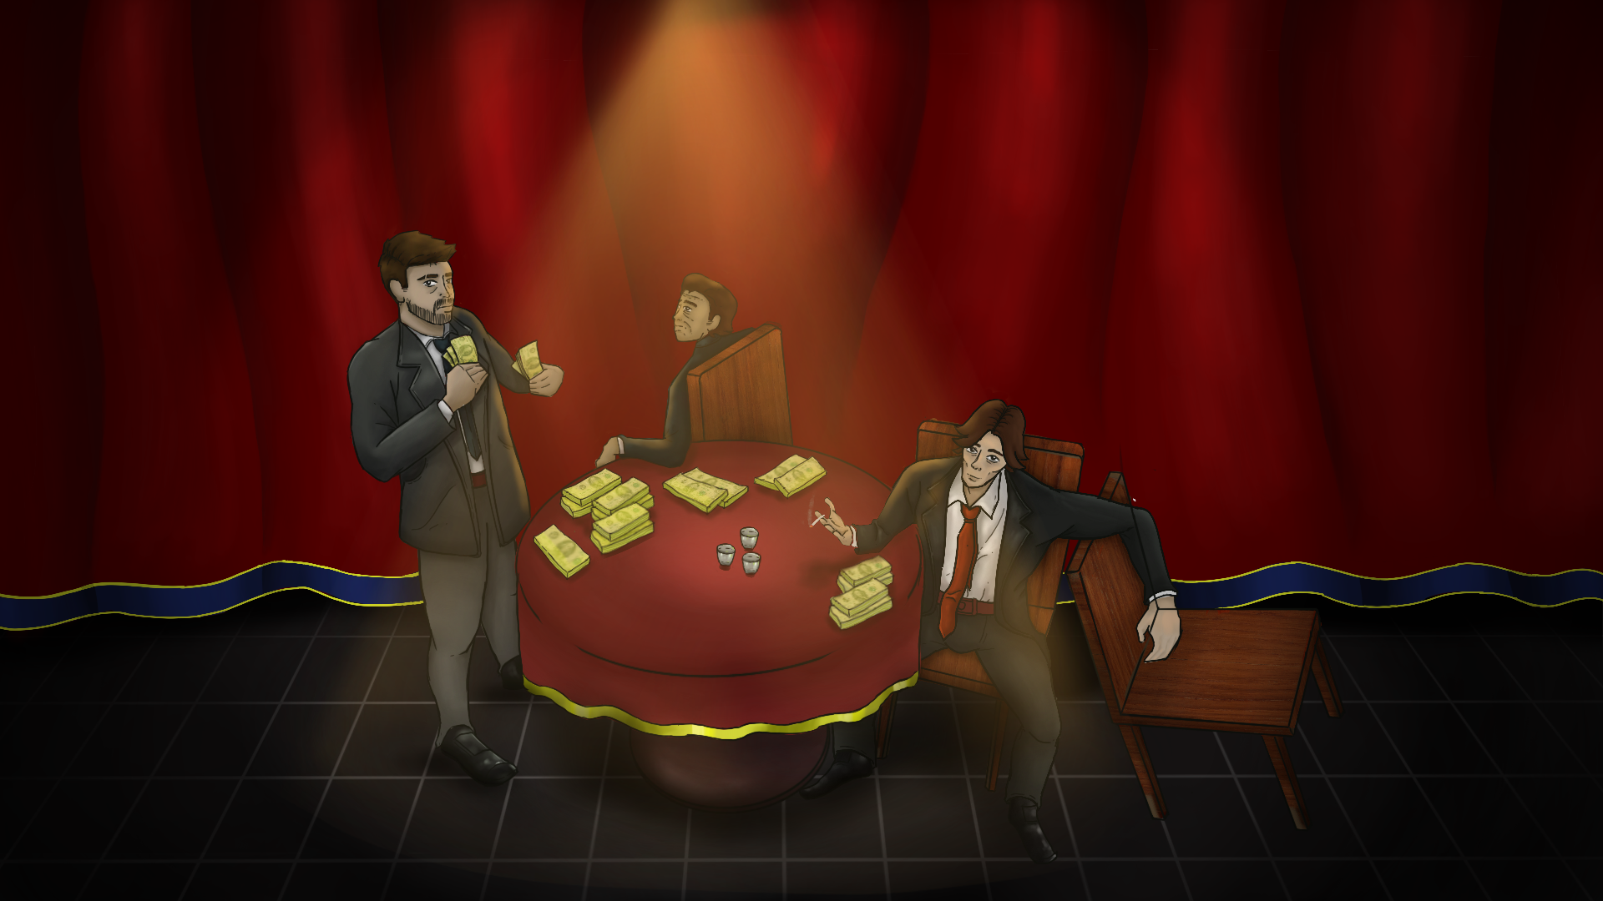
One-Way Ride

Slide 2
Research Topic
A detailed analysis of methods to implement interactive game play around a pre-determined narrative
The main questions that will arise are :
- How can we design puzzles around key story events?
- How to give players enough freedom without making it a handheld experience?
- Storytelling in games cannot be done without spaces. So how does level design aid in storytelling and exploration?
- Does a unique gameplay experience in each chapter of the story add to the novelty of the experience?
- How can you alter player experience based on their prior interactions without changing the overarching narrative?
- How to create a fail state for stories central to the gameplay?

Slide 3
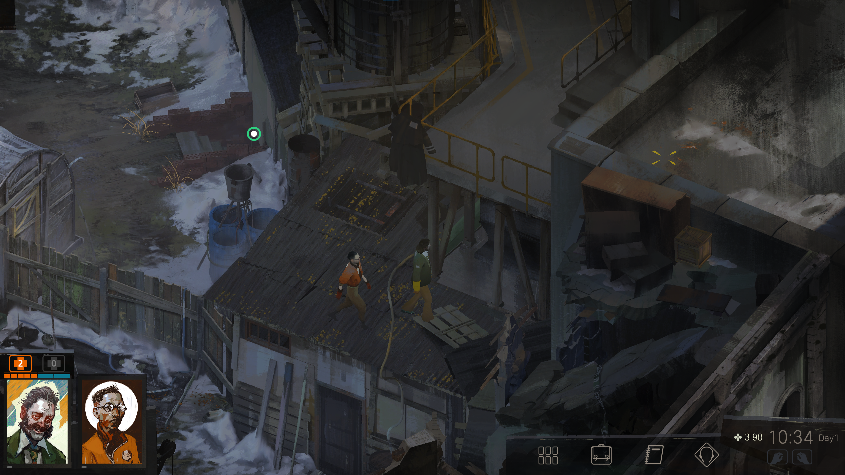
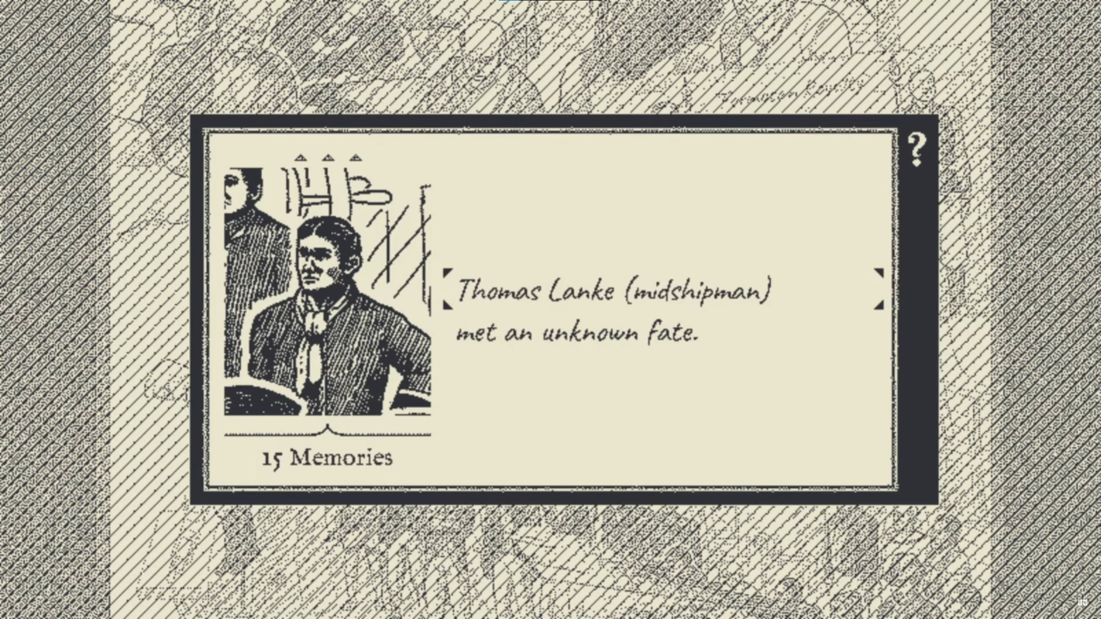
Disco Elysium’s interaction system tries to drive storytelling by exploration and interacting with other people. When you hover over an interactable it gets highlighted. So the player can actually look for clues in a scene. If the player finds it difficult, u can show a the clues with a button. This takes it back to the other extreme of being a handheld experience. Being able to see only the clues within a radius instead of highlighting al the clues would be a better approach to also aid exploration.
Return of the Obra Dinn has a very unique way of storytelling by letting the player figure out the puzzles and not helping them much. You need to figure out who the person is and the cause of his death in the detective game and can only see a short clip of when the person died when near their body. The game pushes you to explore further by not letting you stay in the past and examine the scene for very long periods.

Slide 4
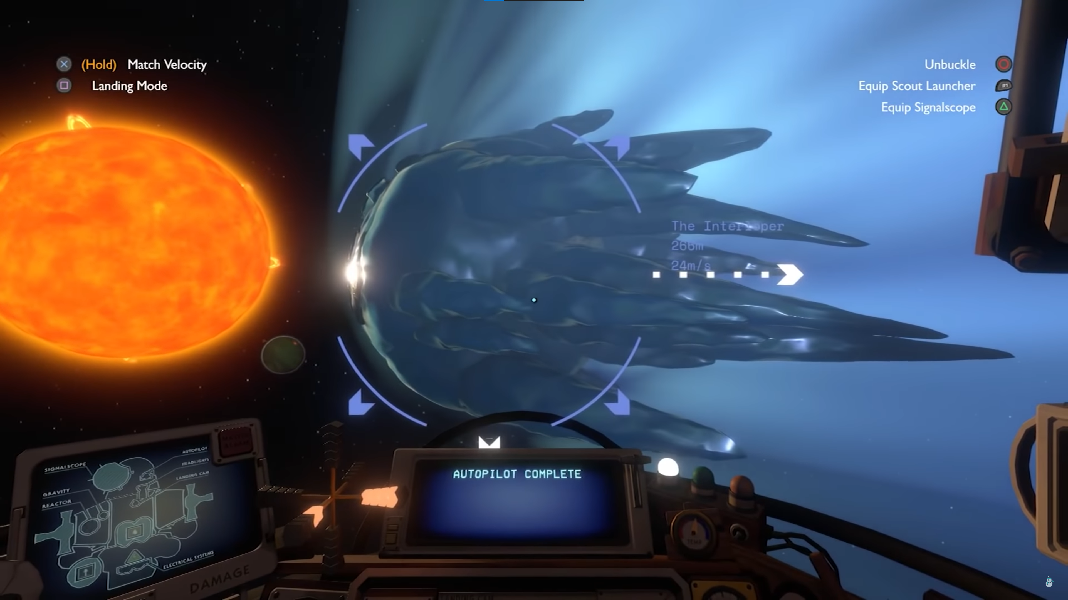
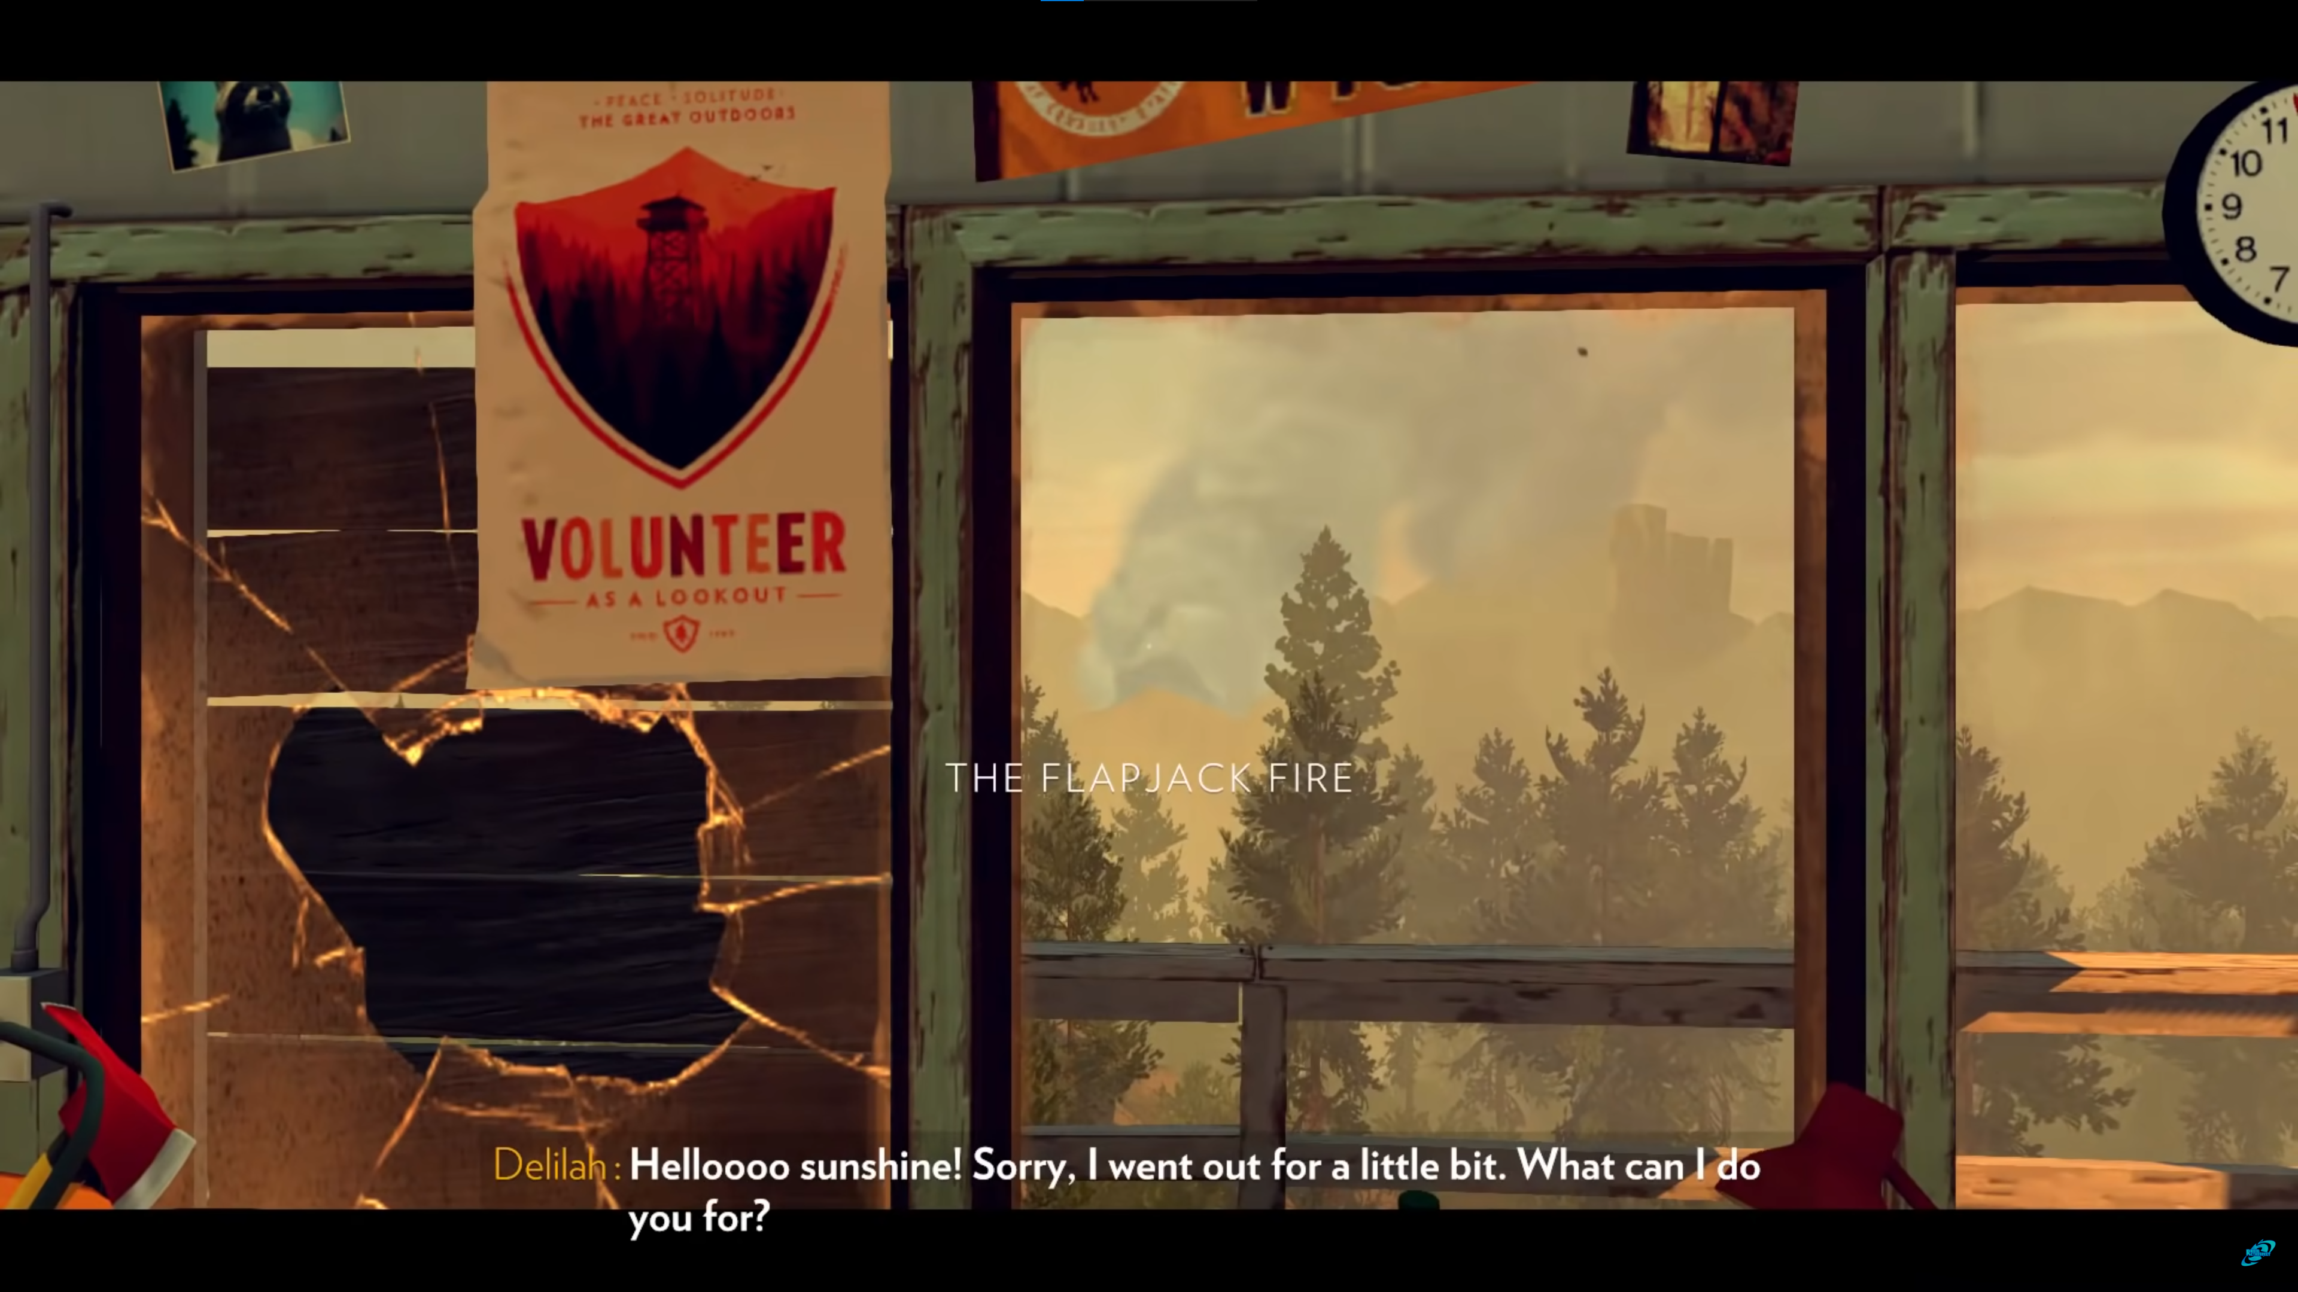
The Outer Wilds’ gameplay loop encourages exploration and uses it as a form of storytelling. It is a game with many interweaving story paths. There are different layers of storytelling which are interlinked and unlock different options based on player interaction. Everyone has a different story as the game is open ended, the environment is generated and the story unfolds based on different encounters.
Narrative design in games is really tough and this game does it all so well because it is built around player experiences. Not everyone is going to have the same experience and storytelling along with its game design is all about giving the player an experience and not just a story.
Firewatch has a more dialogue based storytelling system, it’s boring to read text on the screen and follow the story. Here, the game is made fun by observing players actions and the choices aren’t solely based on player dialogue, but also interactions with the environment and reactivity. Most of the dialogue choices themselves affect the story directly and the player cannot come back and choose other options or try to explore all possibilities. This is a very good example of invisible choices in a game and improves the player’s experience.

Slide 5
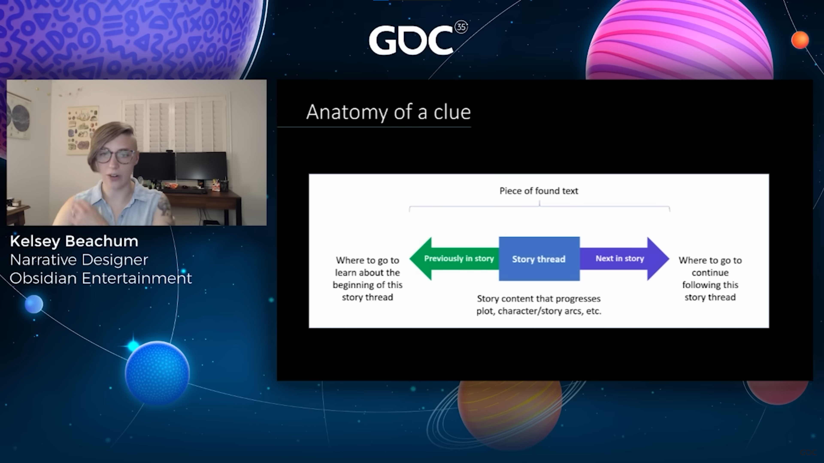
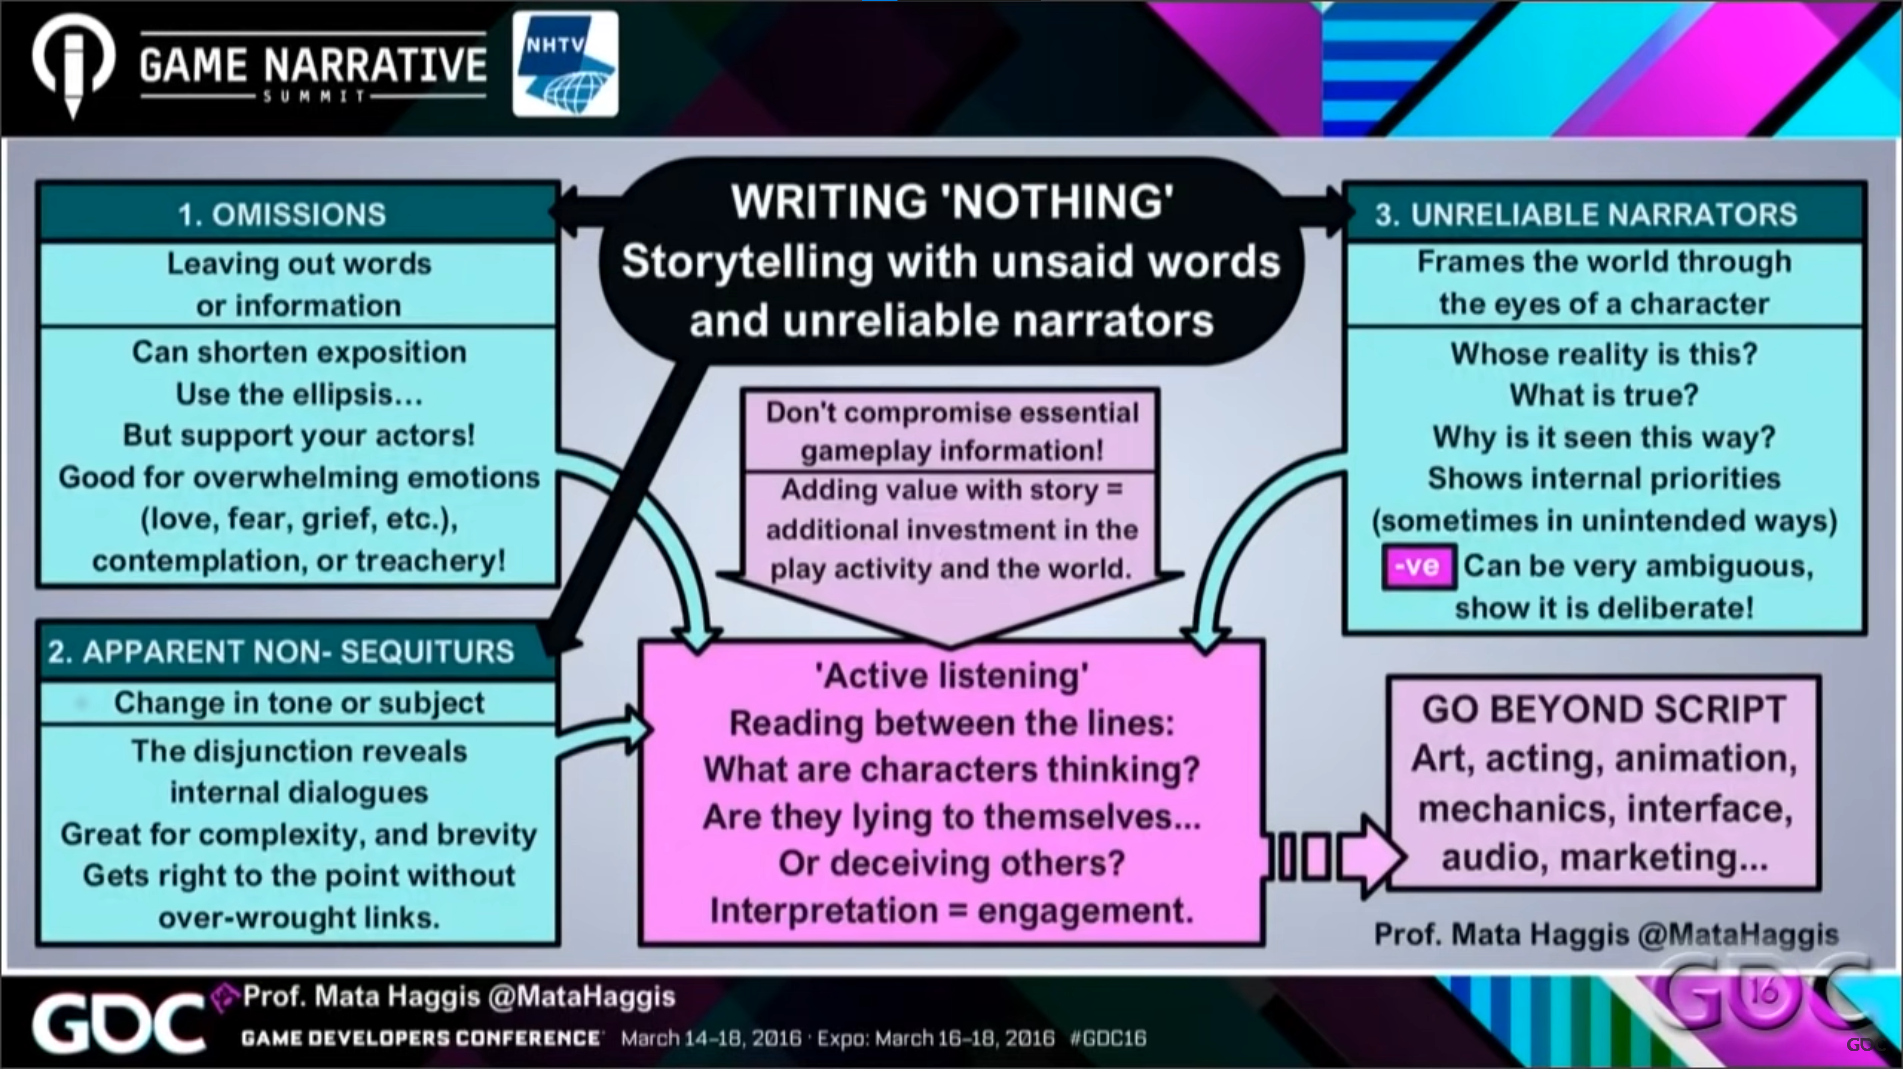
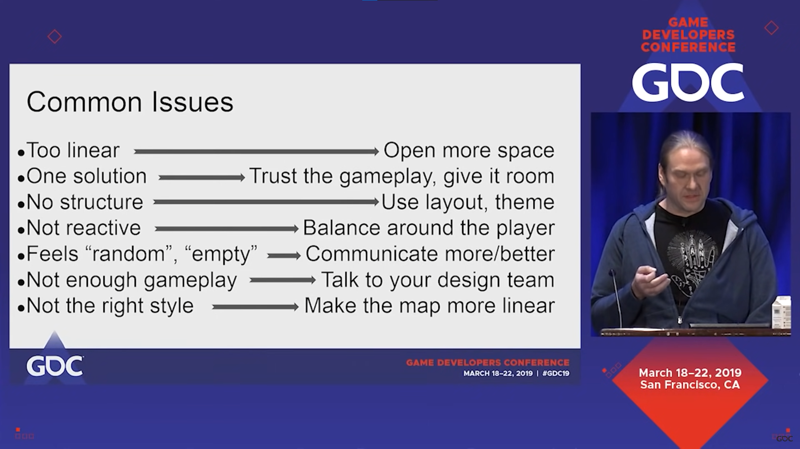
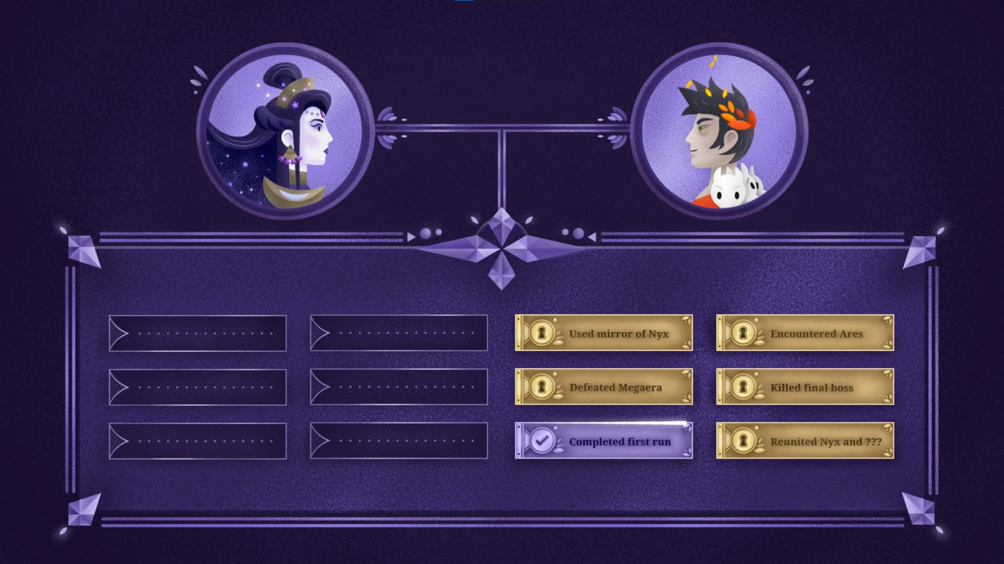
Research/ Screenshots of videos I used to read about narrative, game design and challenges faced.

Slide 6
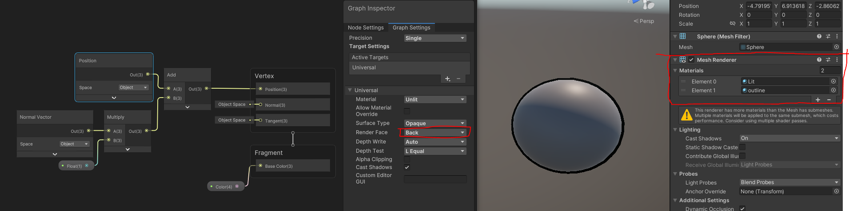
Project Setup
- First GDD
- Describing the project to find teammates – Google Slides
Trying to figure out an outline shader

Slide 7
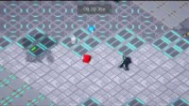
Trying out Isometric 3D, Player Movement and camera movement for the AGDS Game Jam in ROBOLUTION

Slide 8

Working on Player Movement in Universal Render Pipeline in Unity

Slide 9
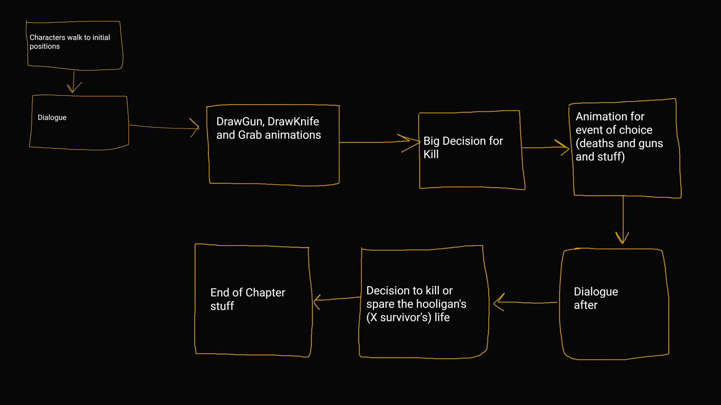
Mapping out scene 1 flow

Slide 10
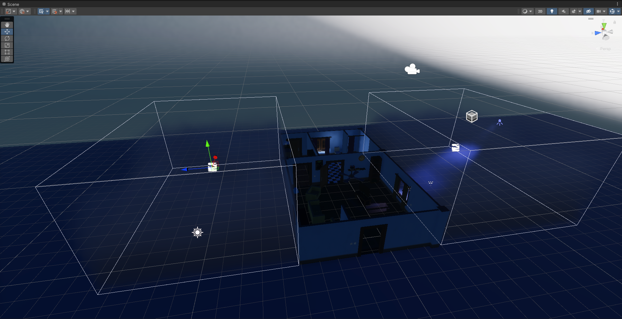
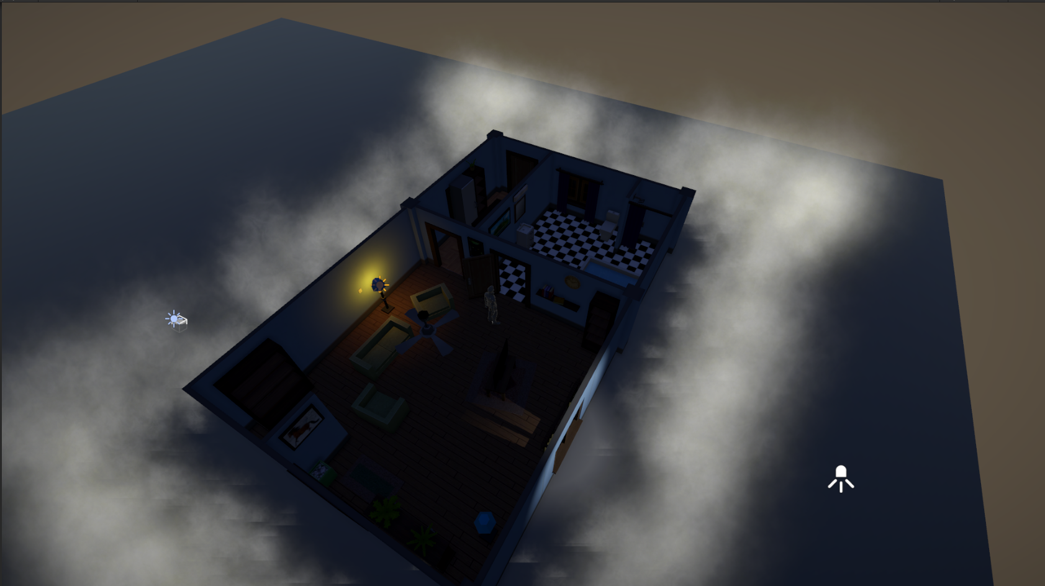
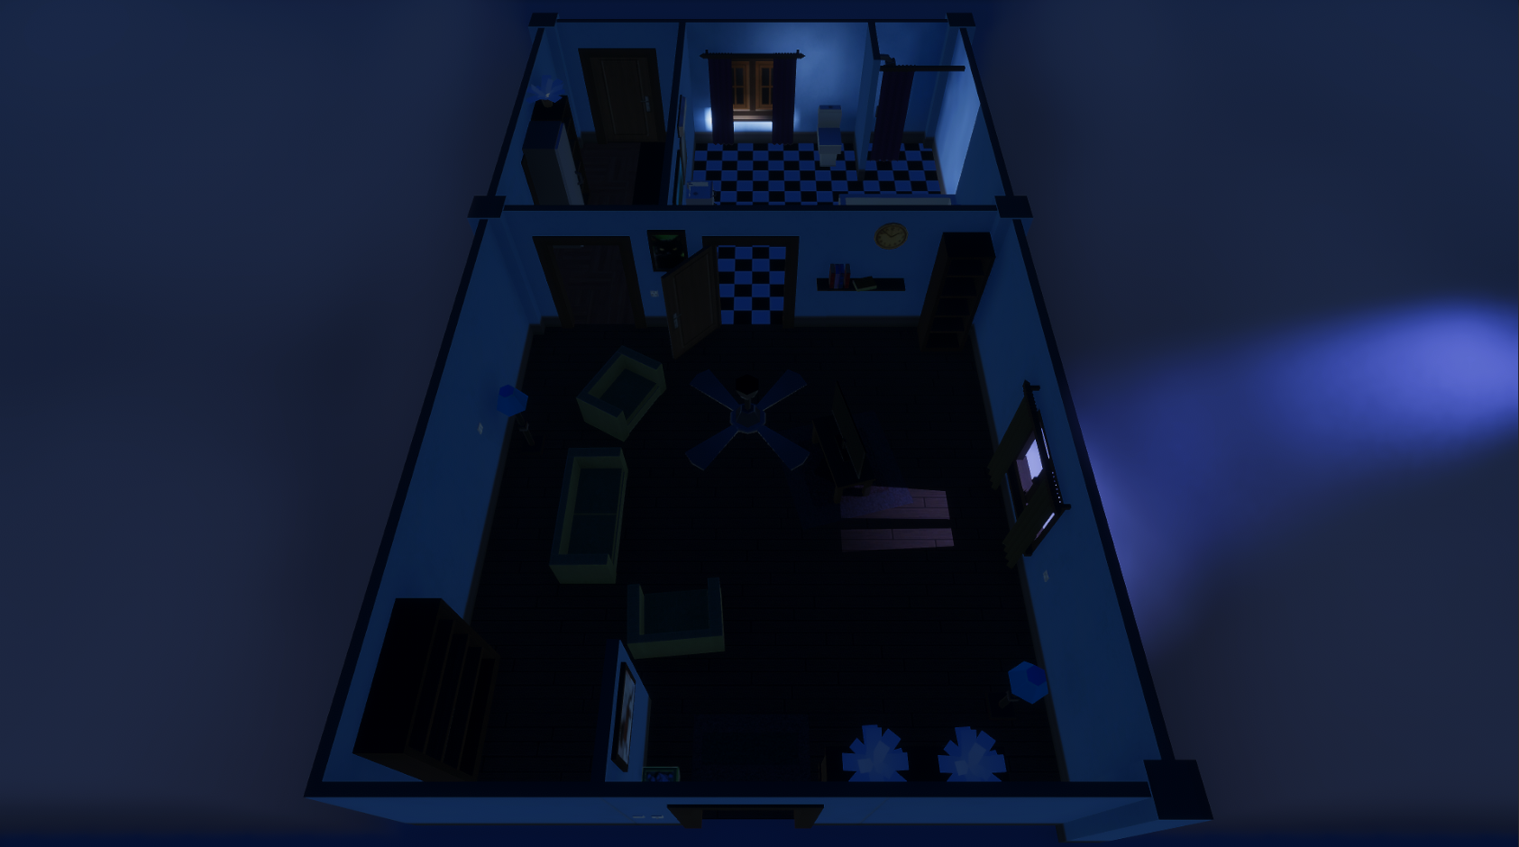
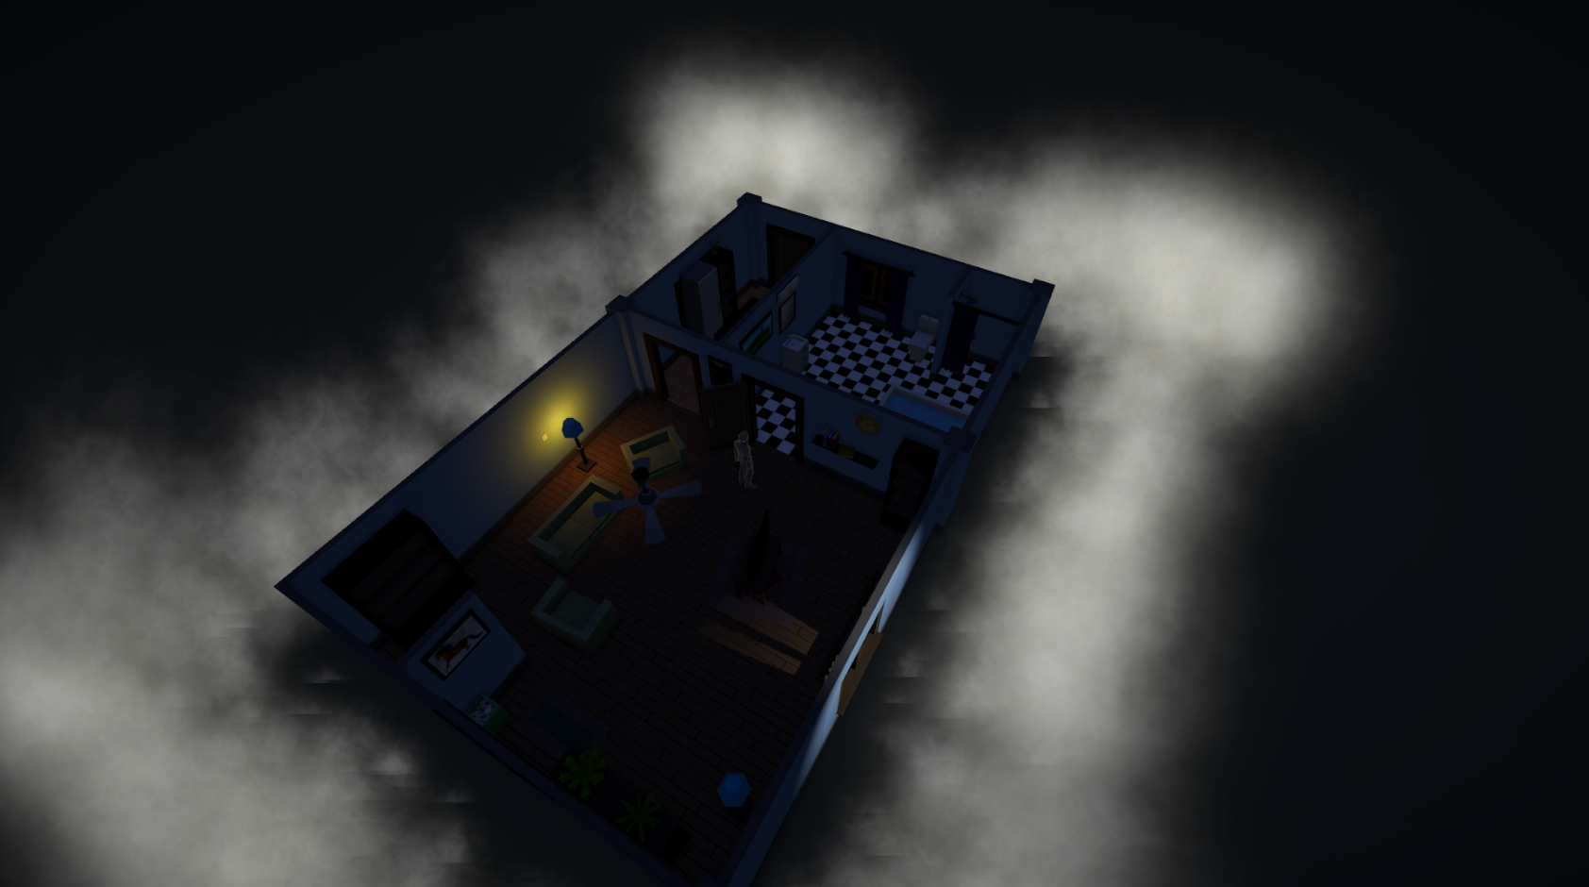
Choosing between HDRP and URP

Slide 11
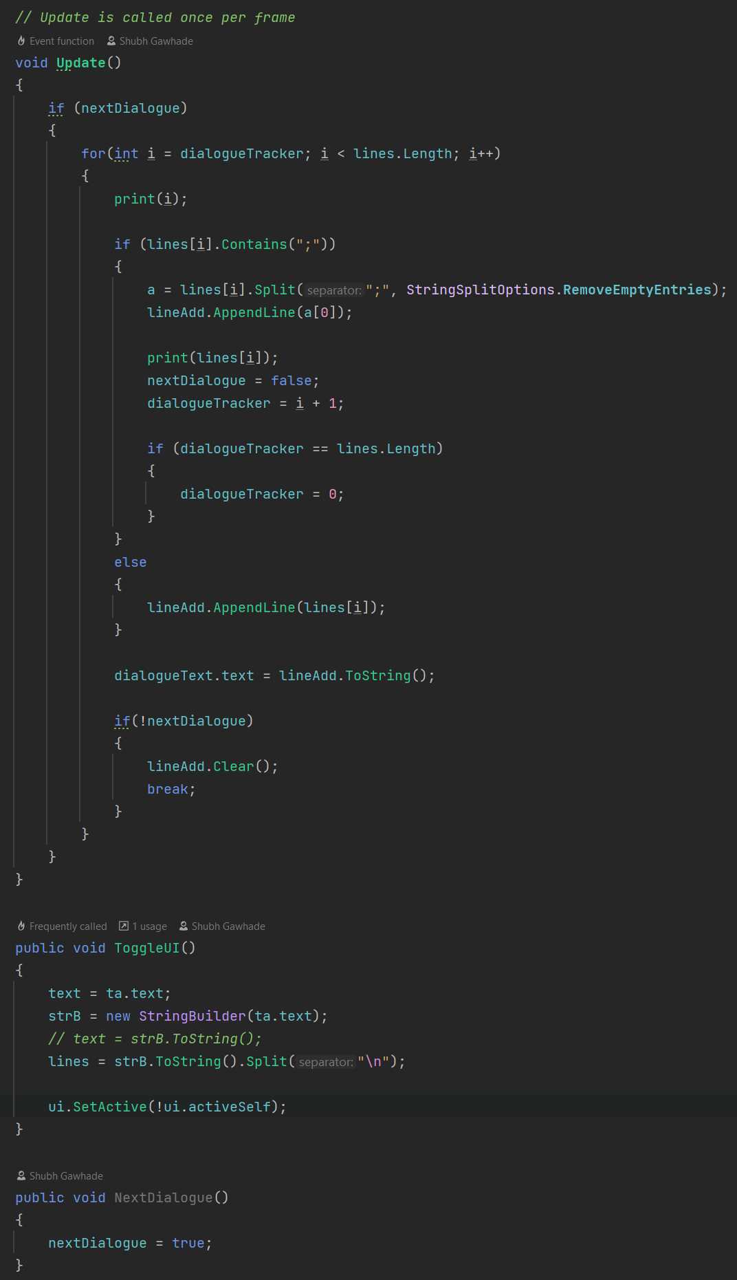
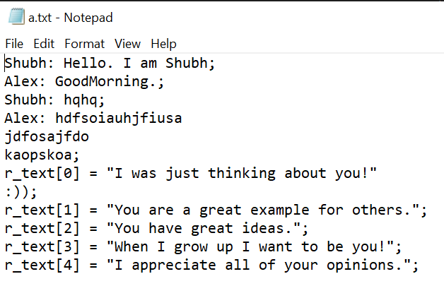
Creating a dialogue system by reading player dialogues from a .txt file
which splits the text which is in a new line and finished player dialogue which ends in a semi-colon(;) and testing it using temp files.

Slide 12
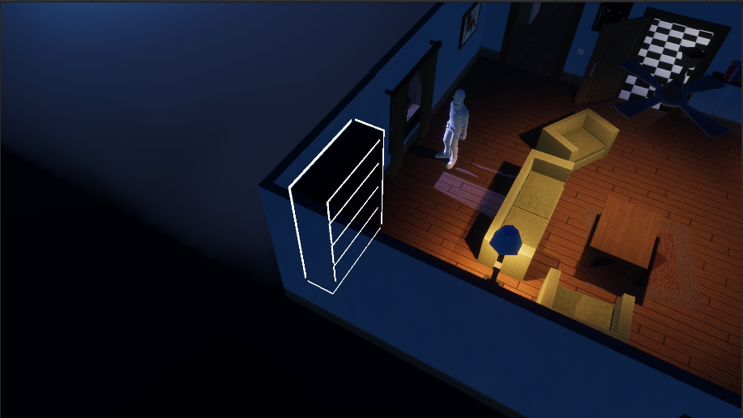
Testing out Interaction system with dialogue system
Testing a ragdoll effect for all humanoids

Slide 13
Gameplay Progress video

Slide 14
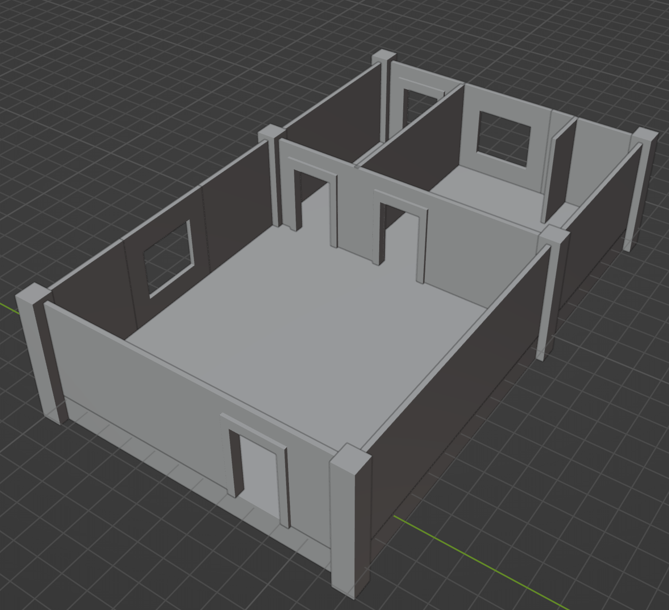
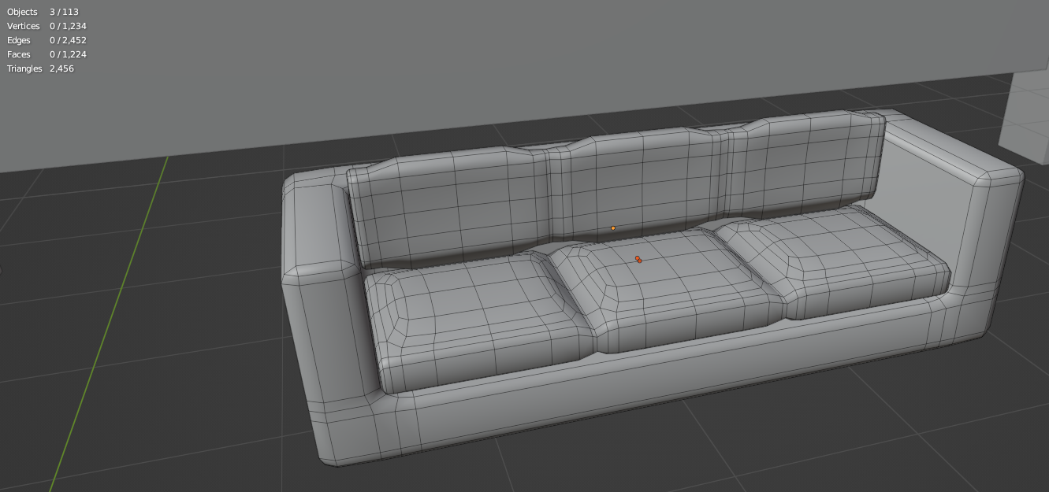
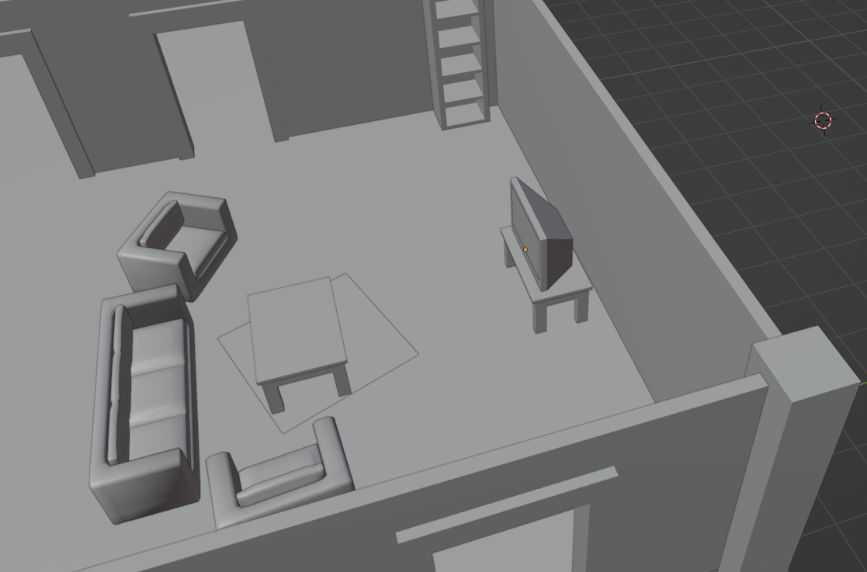
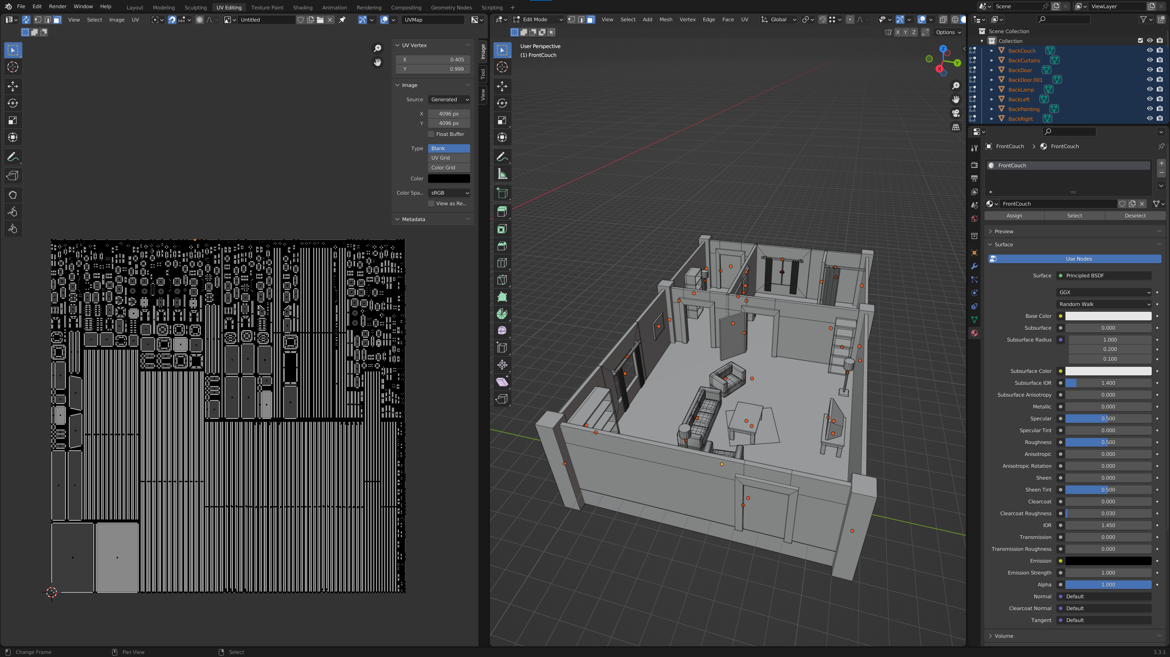
3D modelling the Environment

Slide 15
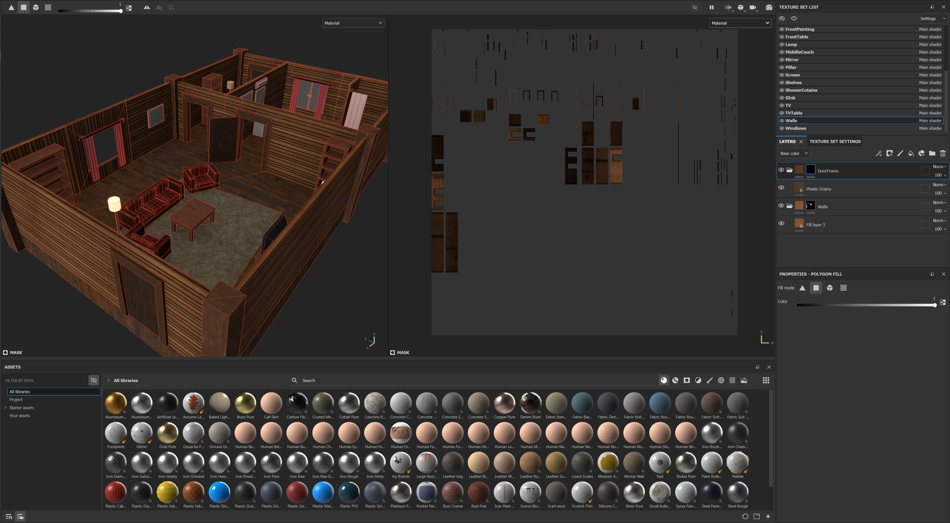
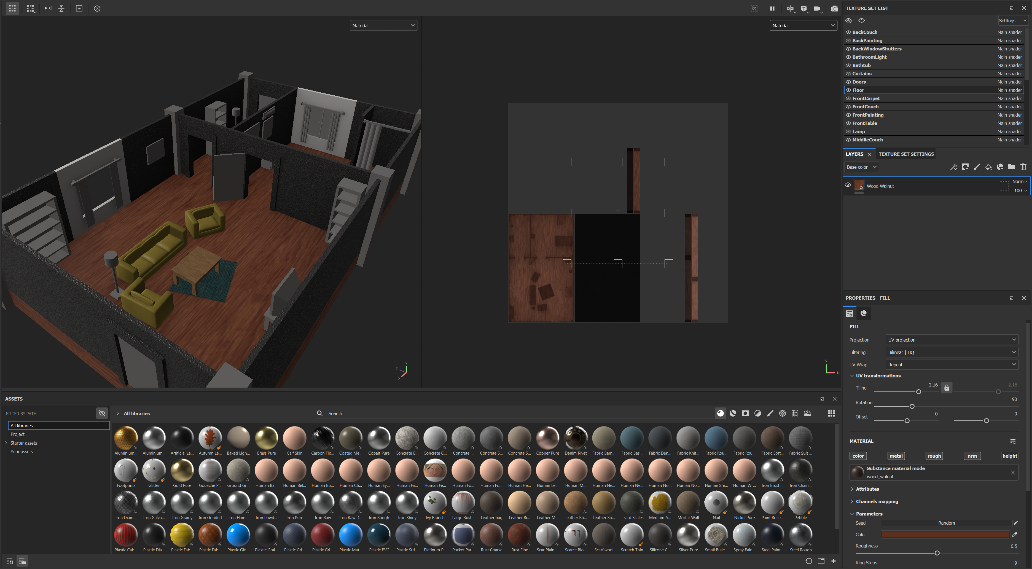
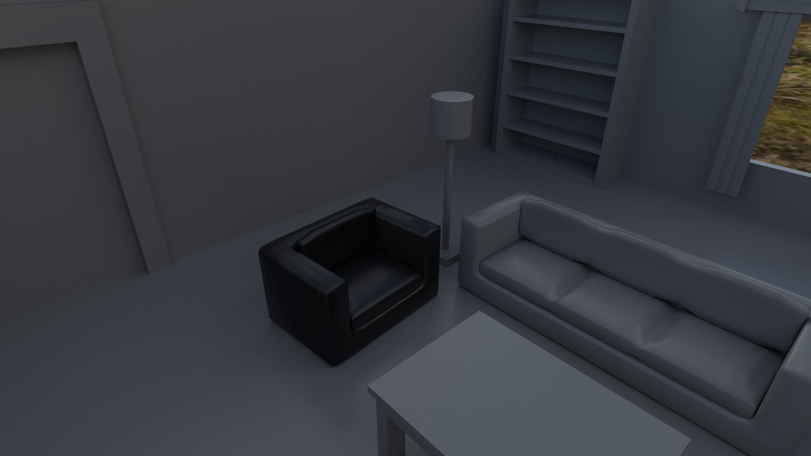
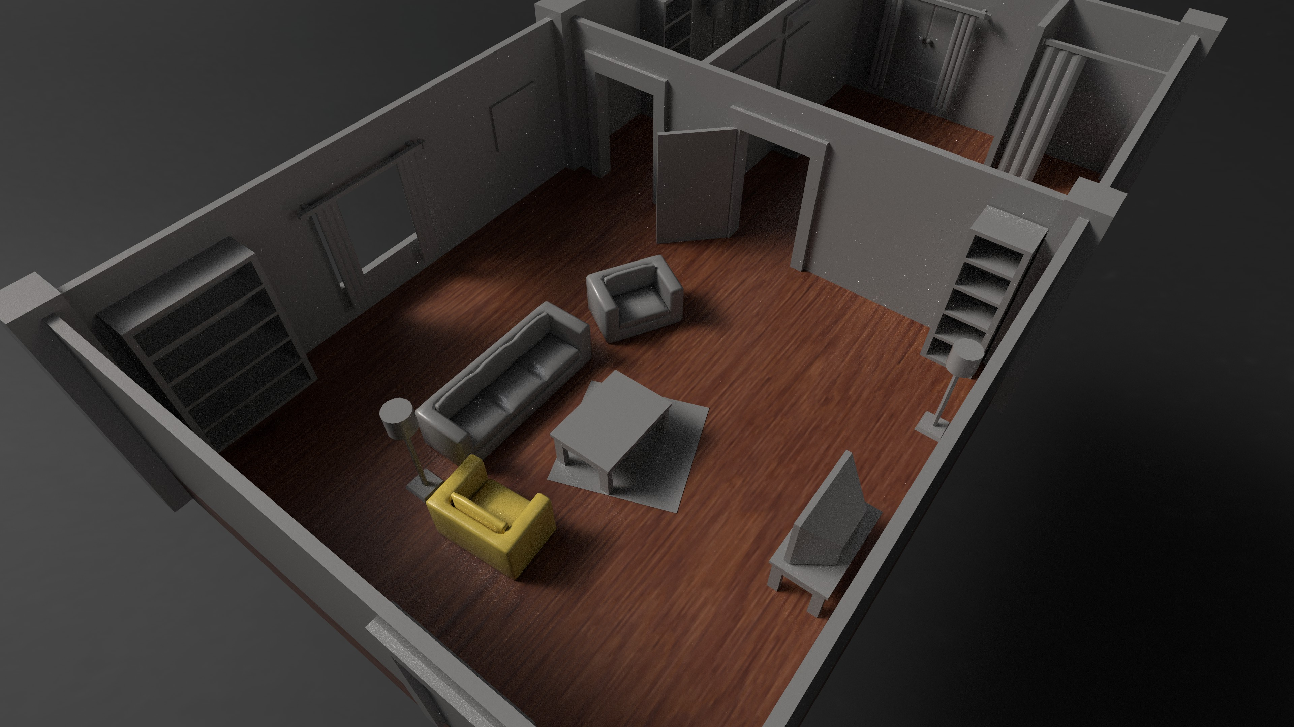
Texturing the Environment

Slide 16
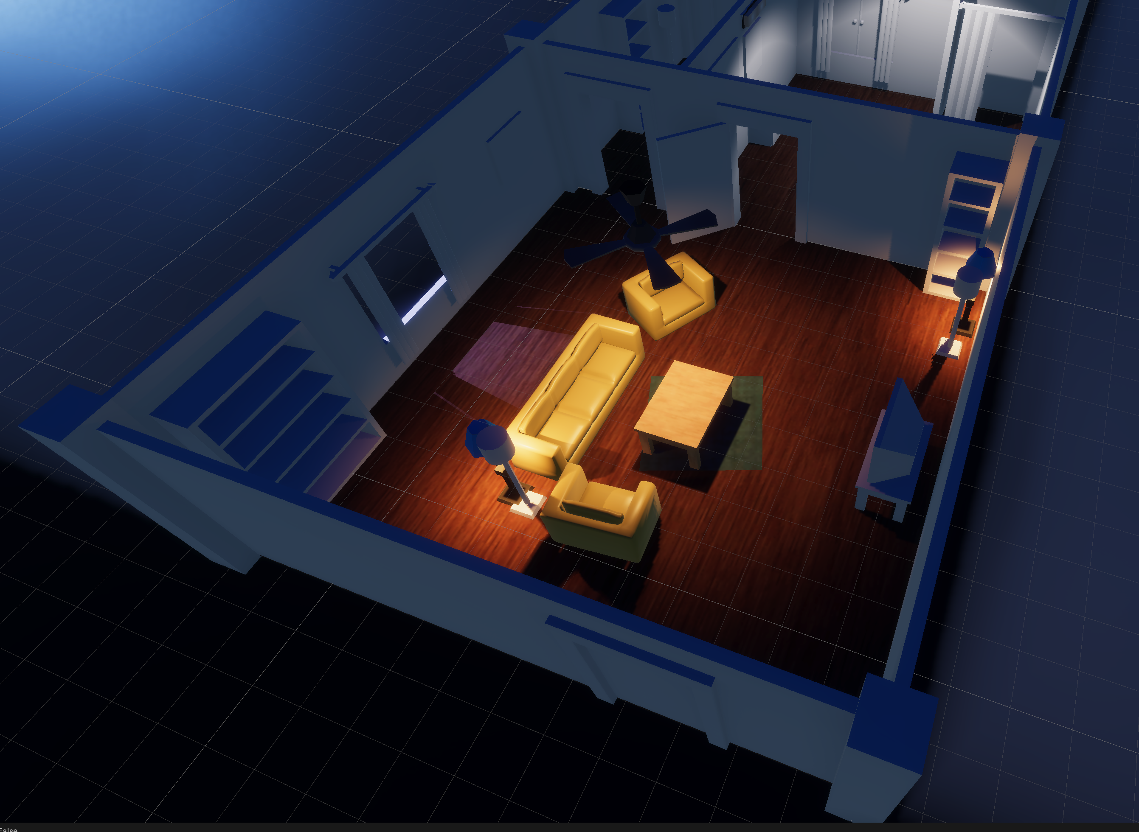
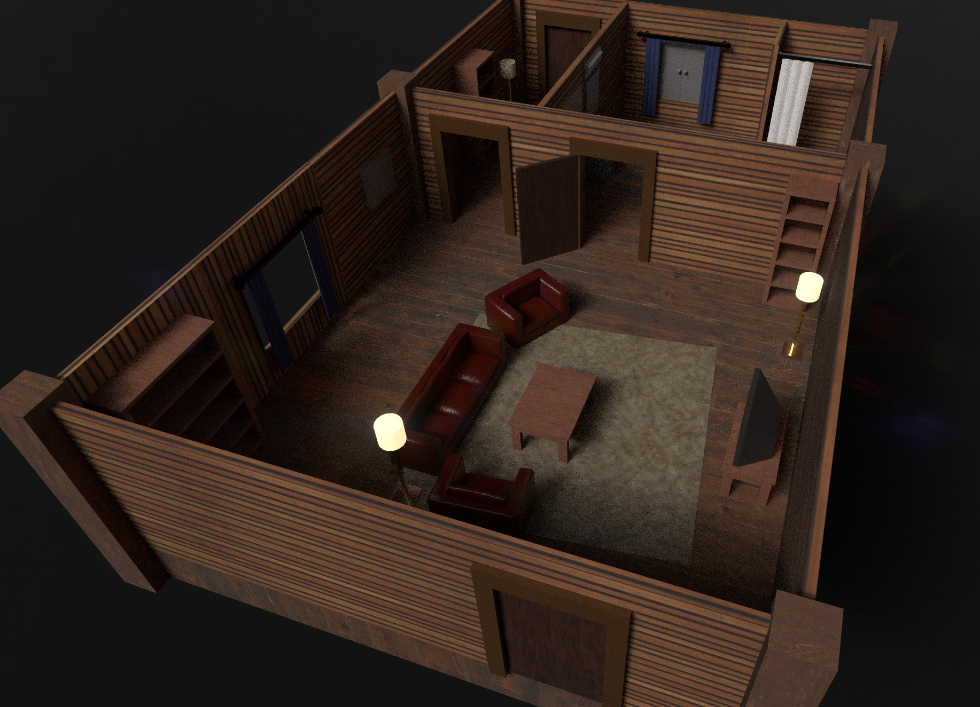
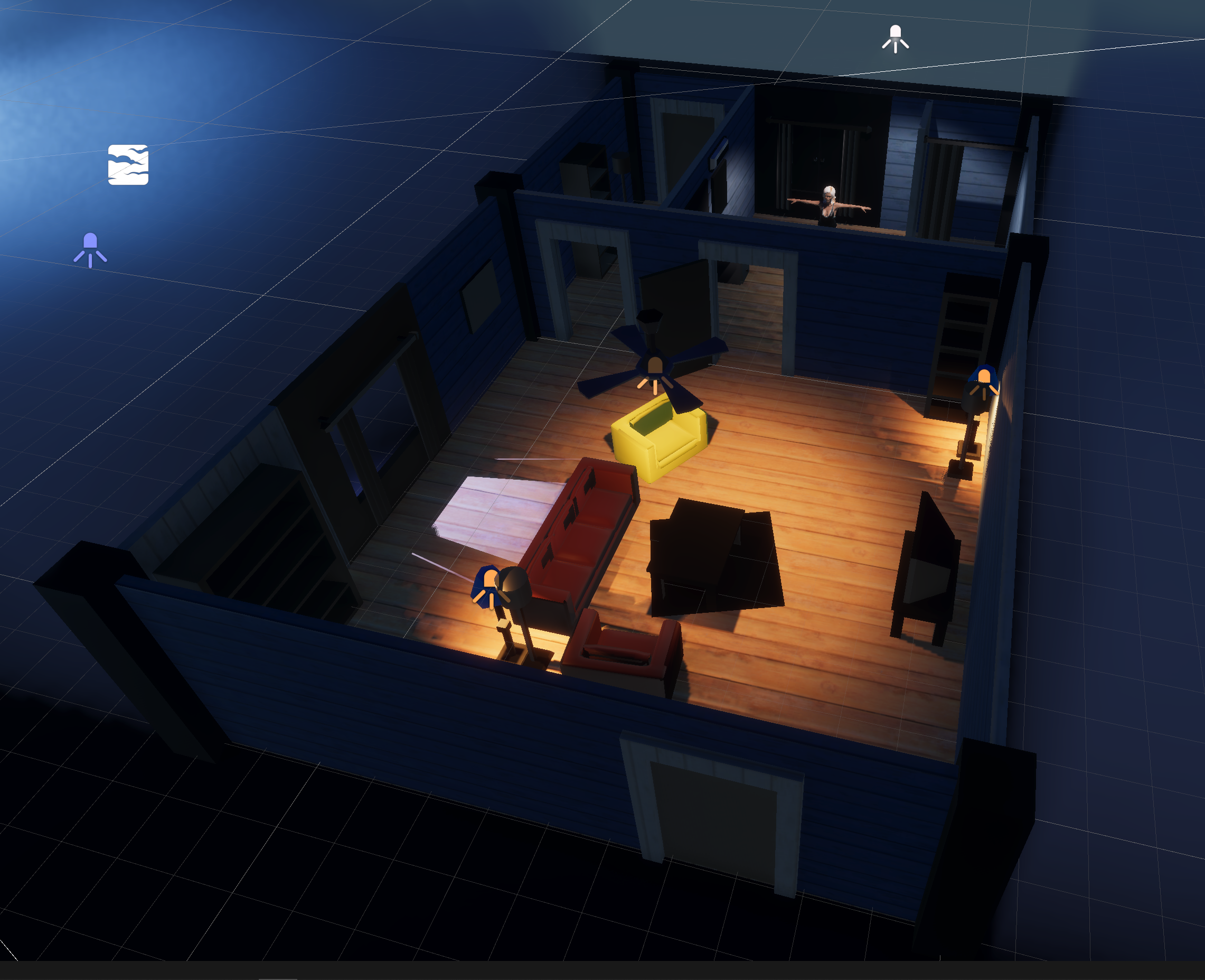
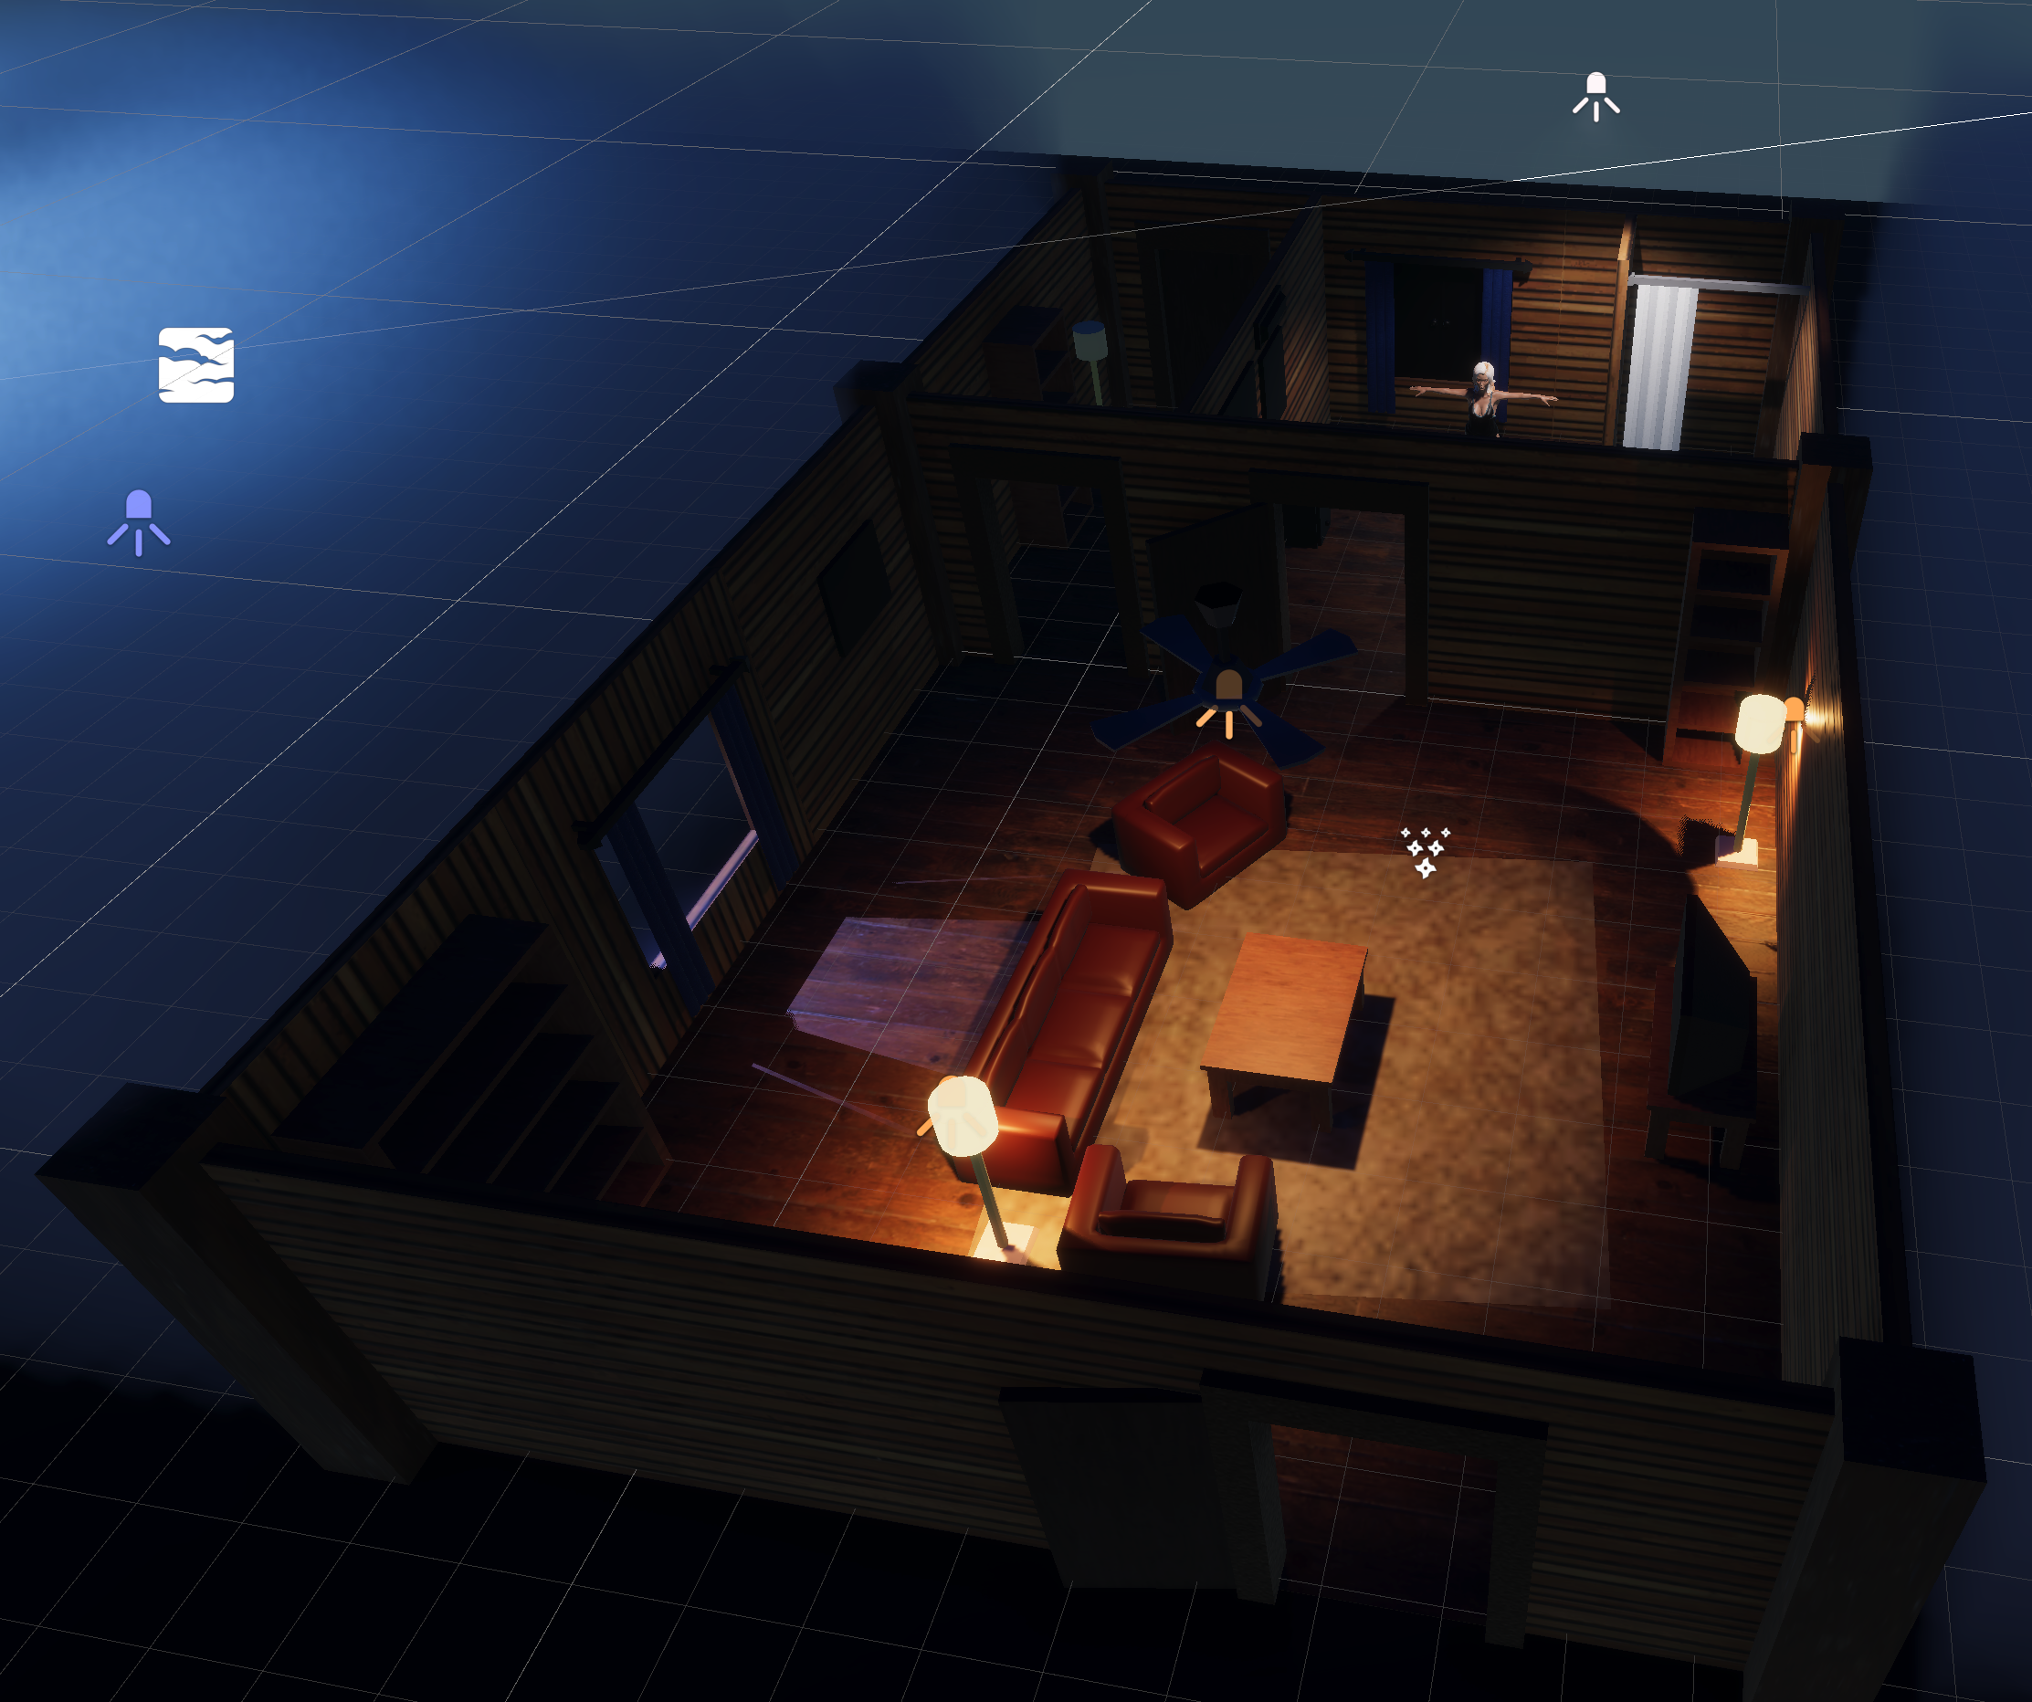
Importing textures and models to unity

Slide 17
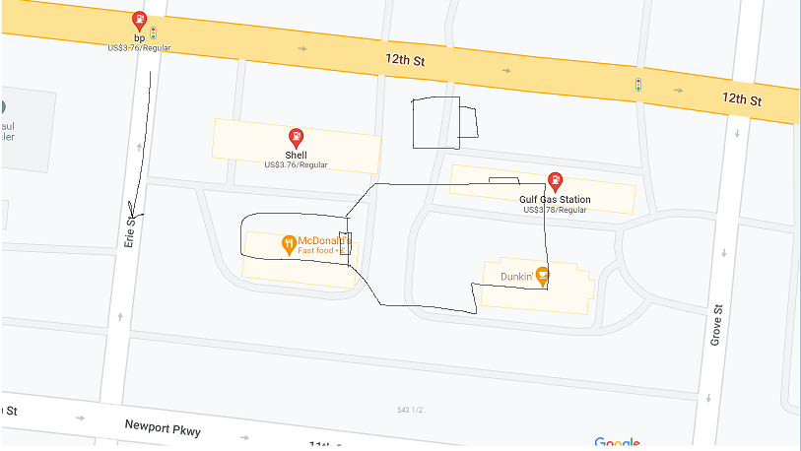
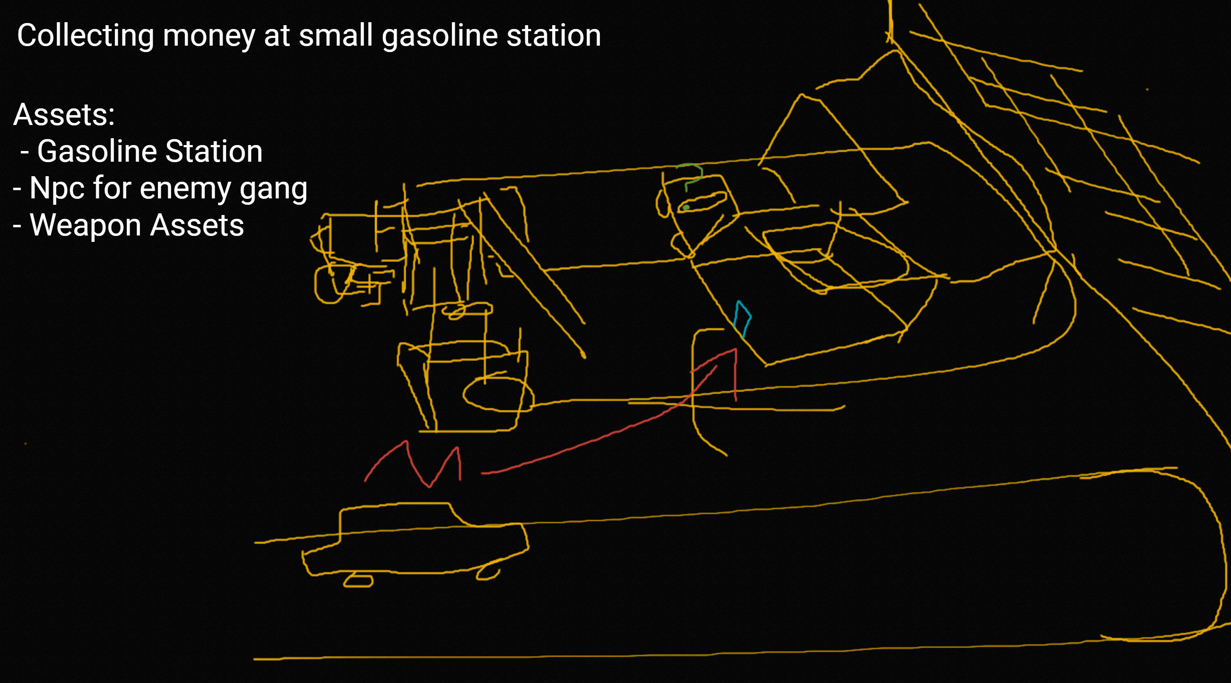
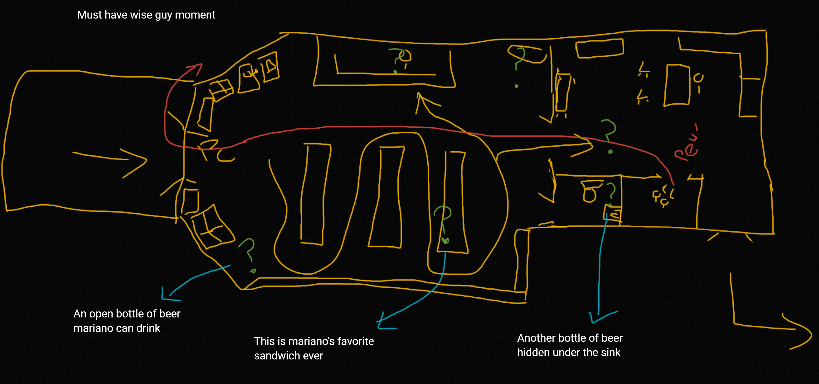
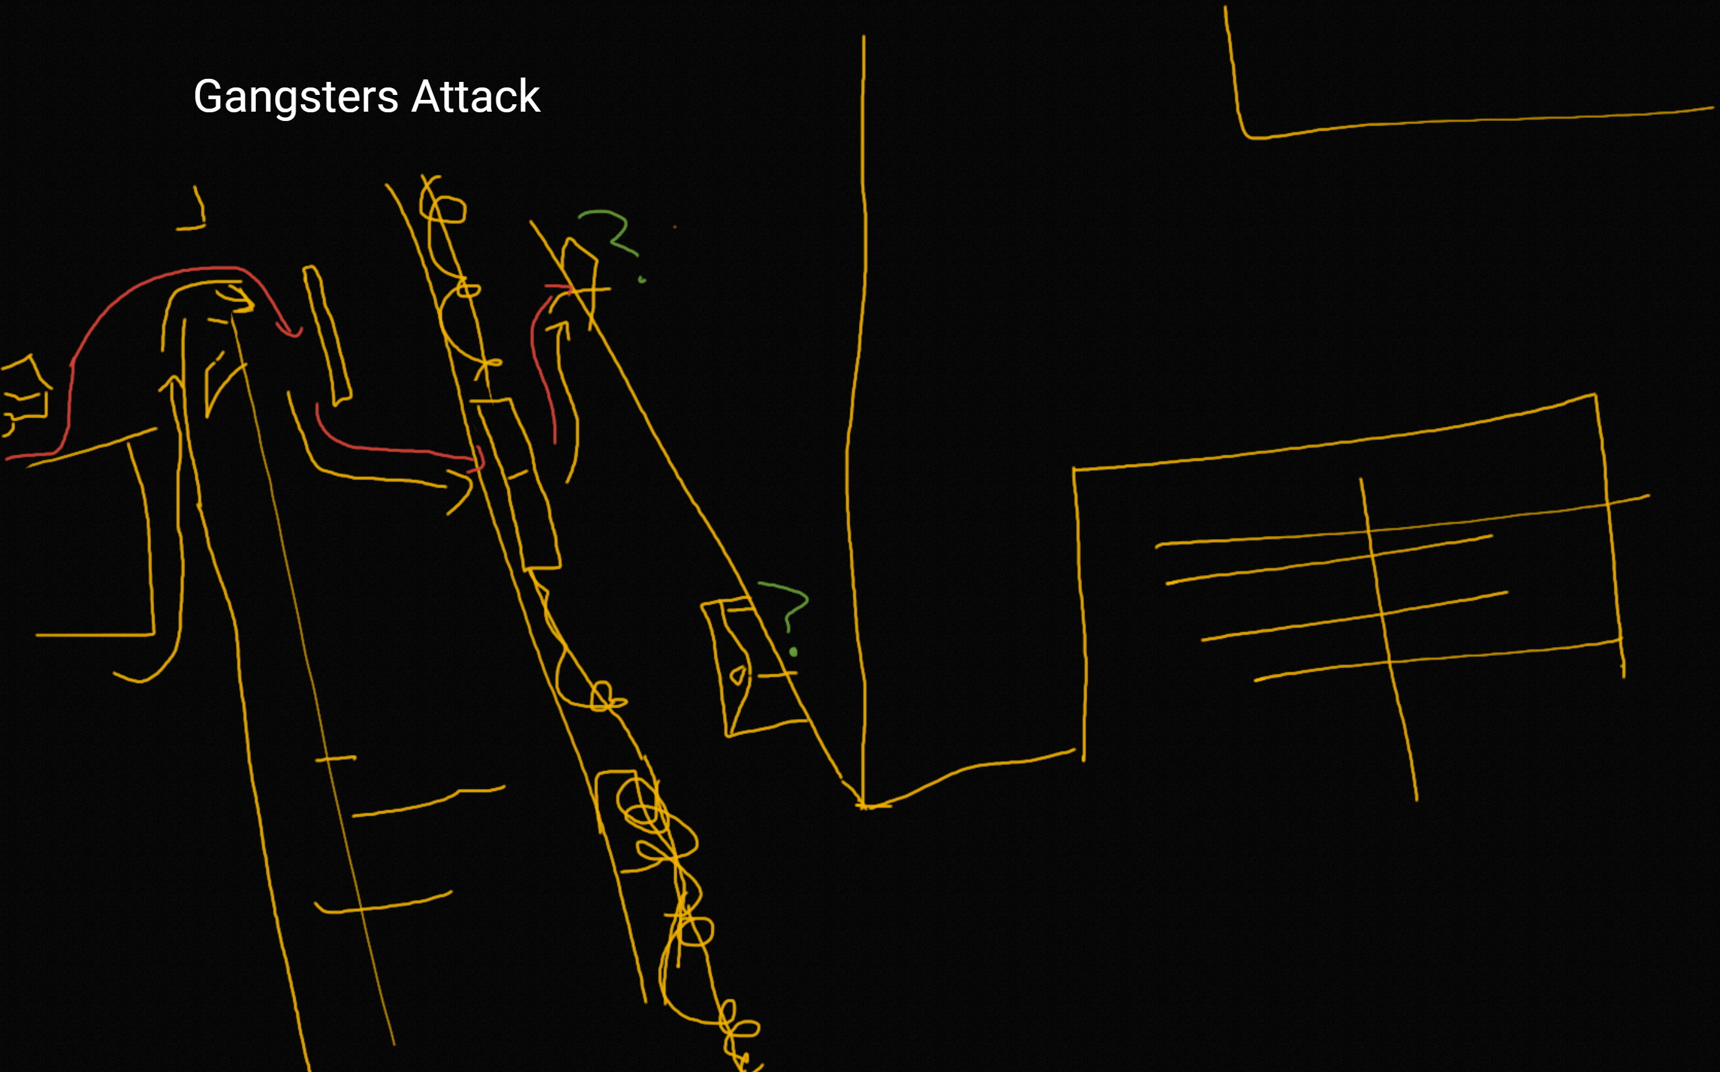
Working on Chapter 2 - Layouts and Gameplay around the story

Slide 18
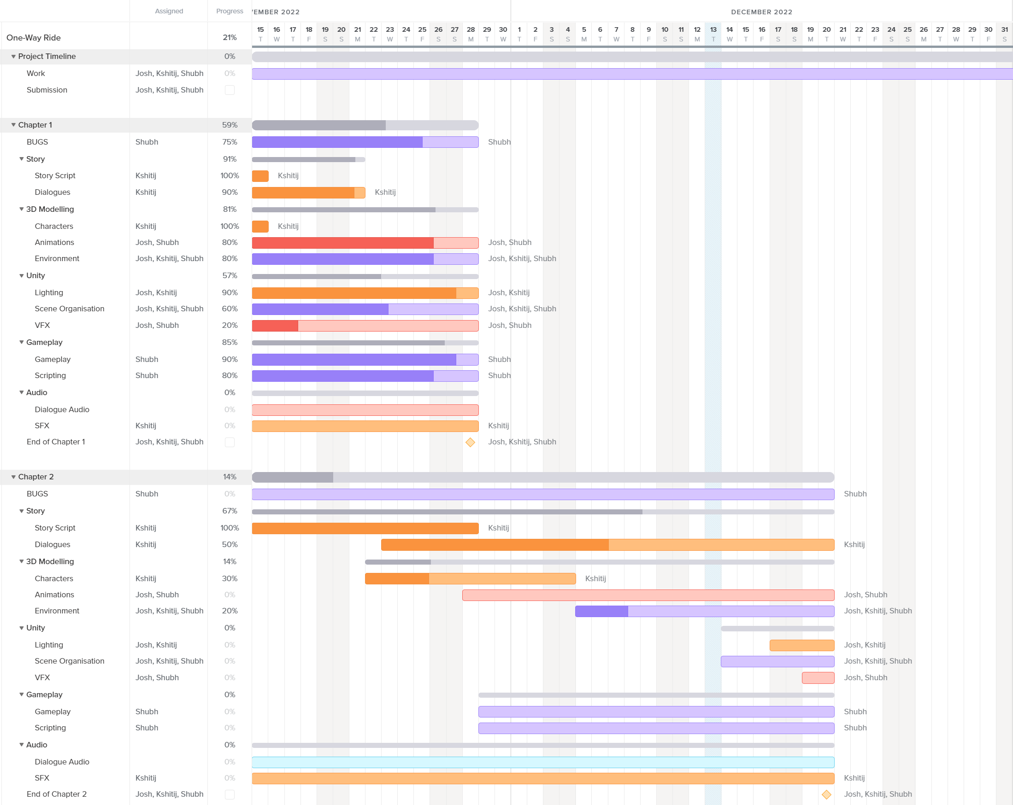
Gantt chart till the end of year 2022
Notes:
The game will have a top down, isometric view which is like to Disco Elysium. Since we are trying to tell a story, the game mechanics will be based on the story and it will be mostly linear. The gameplay is inspired from “What remains of Edith Finch” and is very narrative driven having effortless, easy and yet unique puzzles.
I’ve always liked prototyping games. Since this is my hons year project, I wanted to work on something more challenging and this project is a more ambitious that the other games I’ve worked on. It will be helpful to have it on my portfolio as I want to start my own Studio. This will showcase my design and development skills as well as being the team lead will show my project management.

